Slide 1
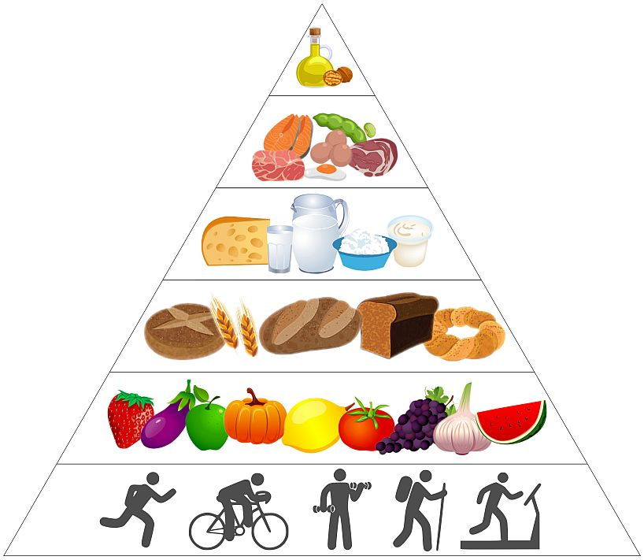
HEALTHY FOOD IN MY LIFE
BY NATALIA ZYCHAL 5A

Slide 2
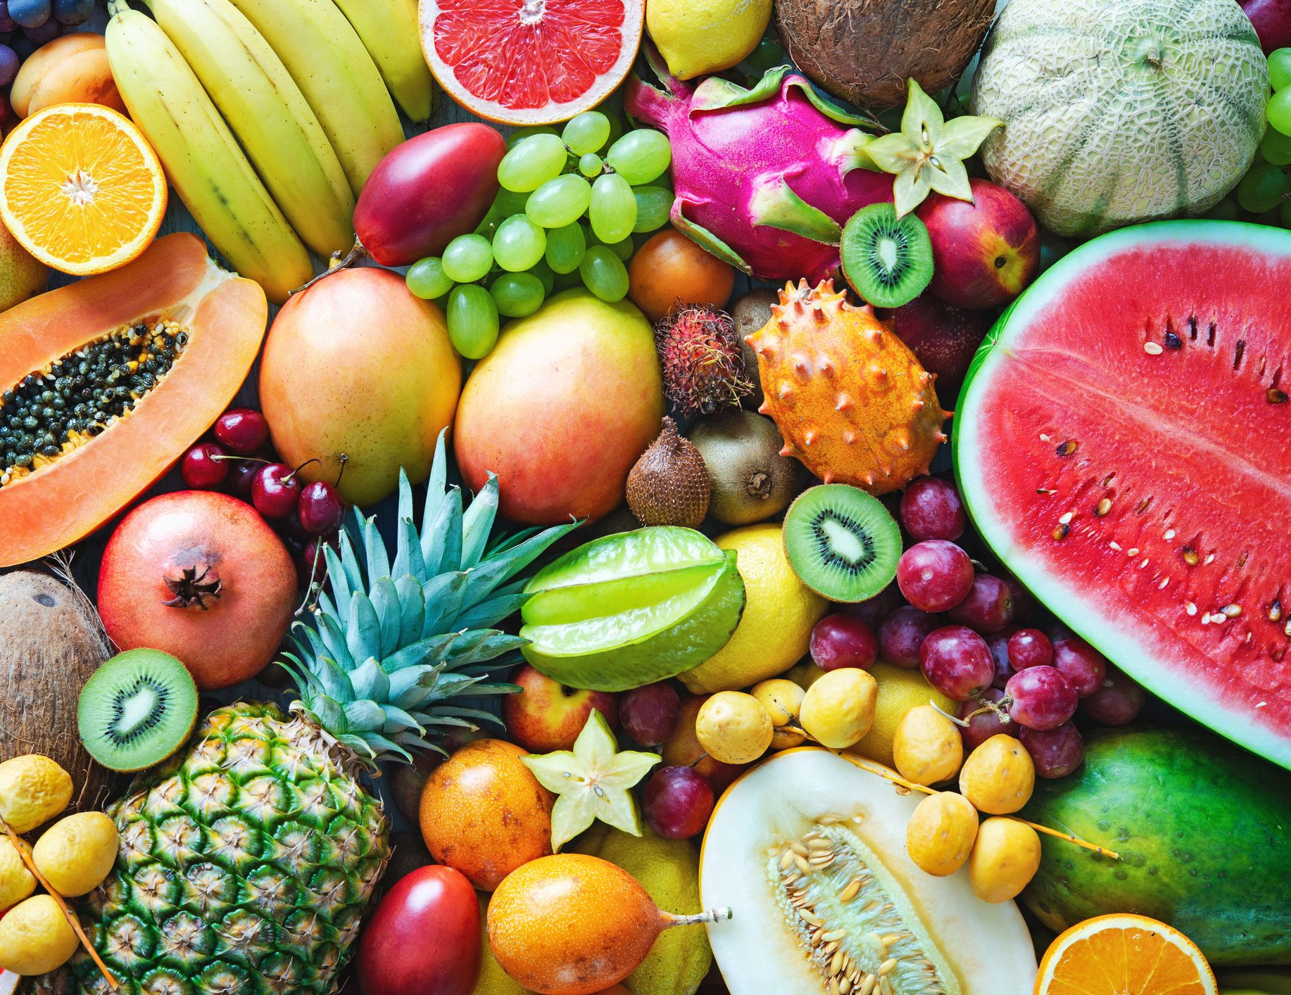
First, let's start with the fruit! :D

Slide 3
Some fruit I eat:
Watermelons
Apples
Mangos
Strawberries
Redberries
Blueberries
Oranges
Cherries
Nectarines
Grapes
Plums
Raspberries
Pears
Lemons
Limes
Avocados
Melons
Coconuts
Pineapples
Peaches
Kiwis
Mandarins
Bananas

Slide 4
Now it's time for vegetables I eat! Yay!

Slide 5
A little bit of vegetables I eat:
Carrots
Cucumbers
Beetroots
Corns
Salad
Lettuce
Potatoes
Tomatoes
Pumpkins
Radish
Pepper
Cauliflower
Mushrooms
Beans
Onion

Slide 6
Now some types of dairy I eat. Wooho!

Slide 7
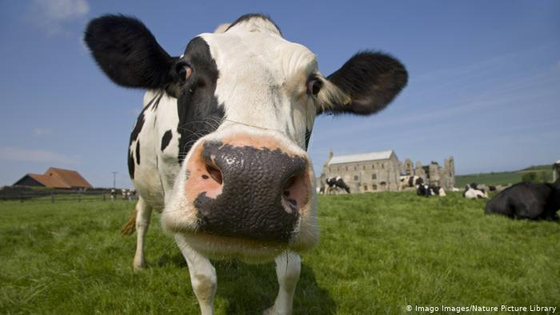
Now some dairy I eat:
Milk
Cheese
Curd
Mozzarella
Camembert
Yoghurt
Eggs

Slide 8
Now types of meat I eat. :D

Slide 9
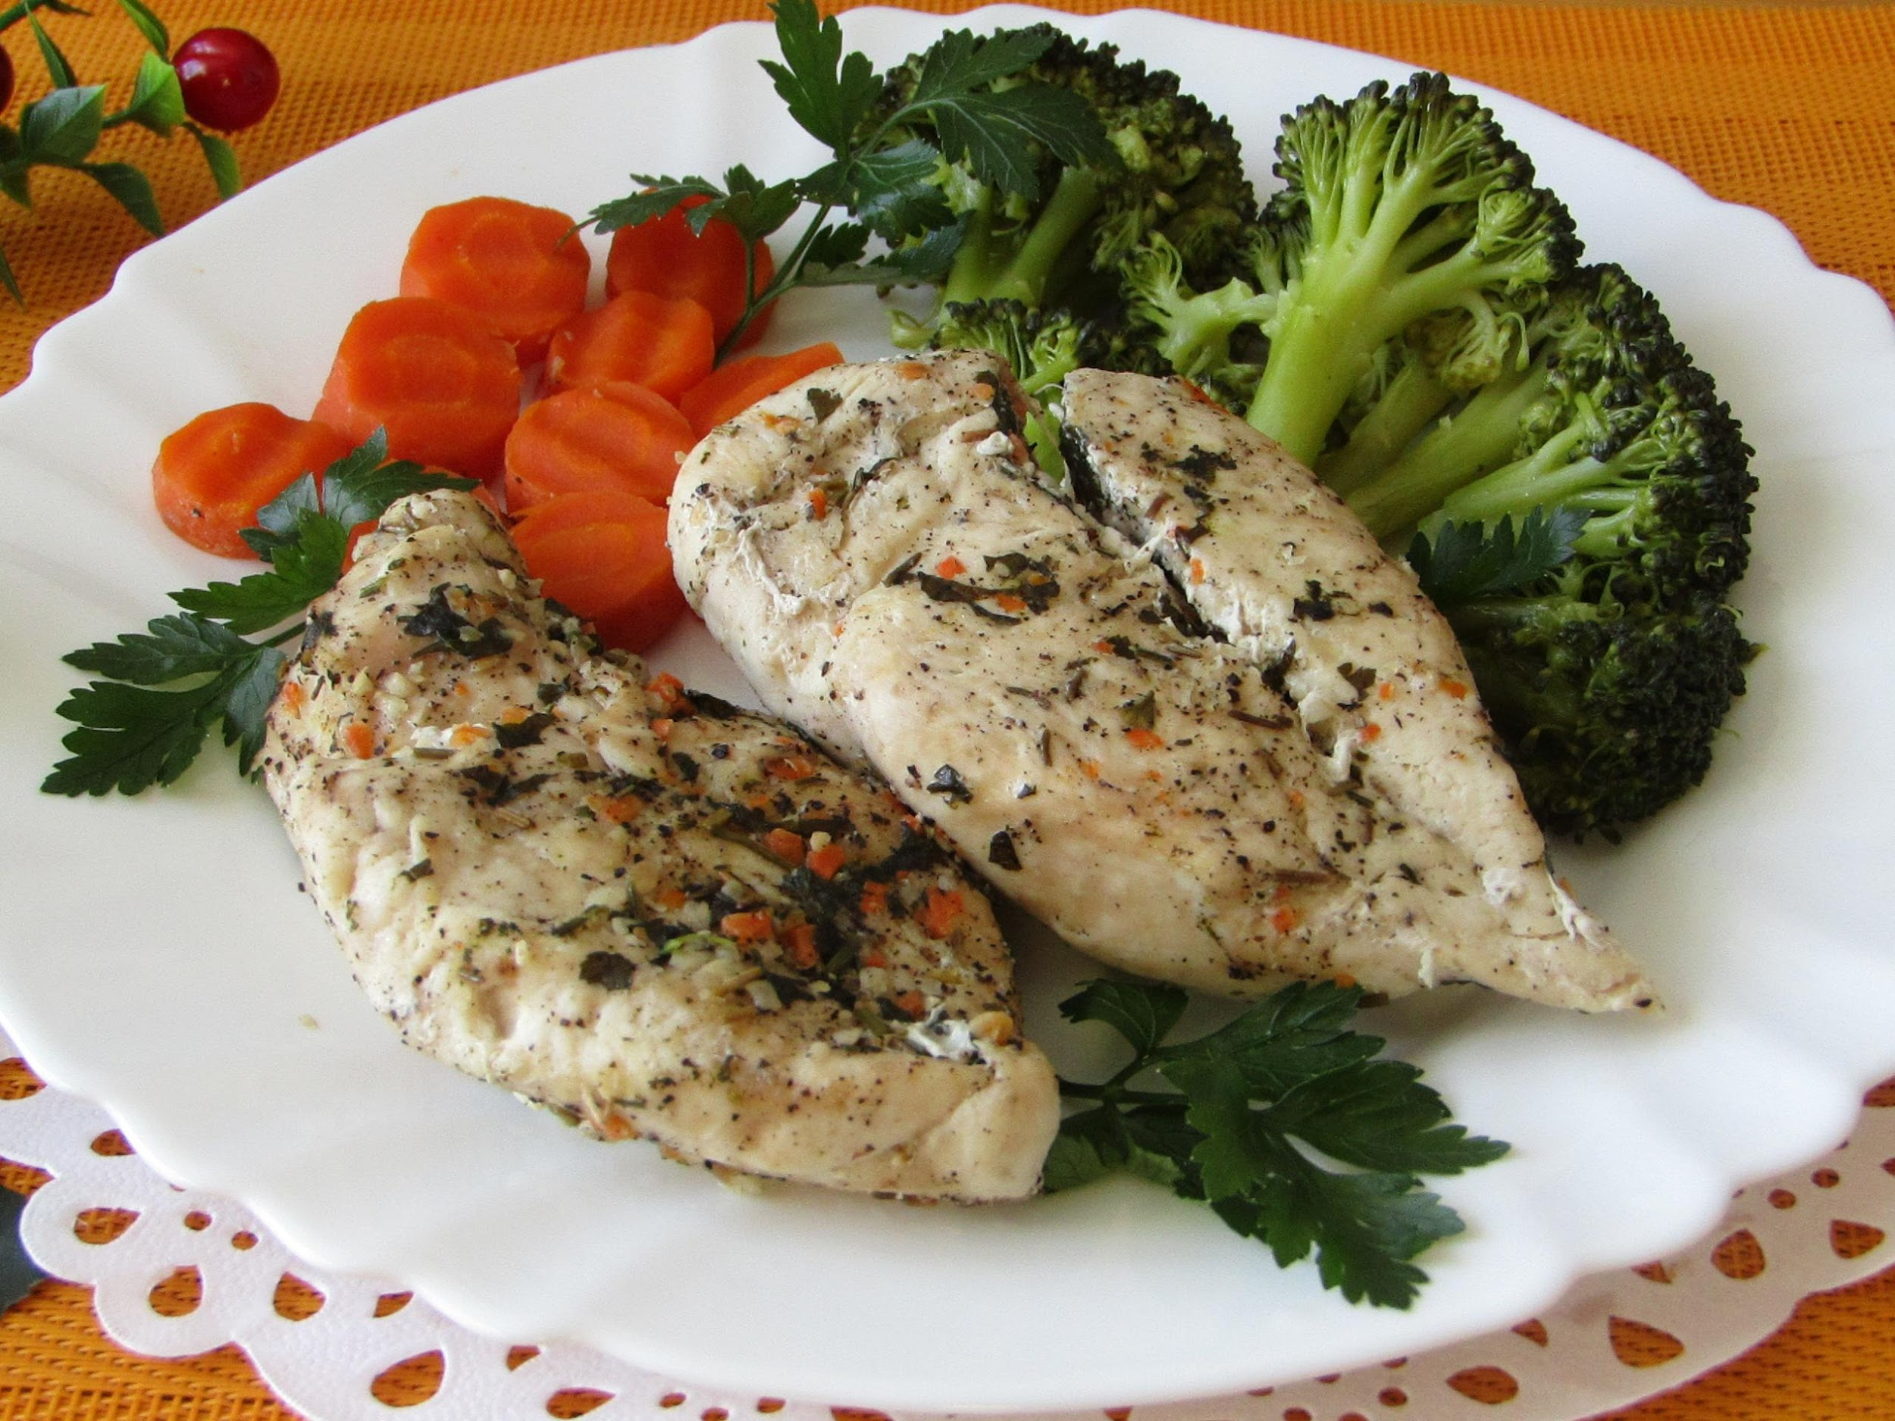
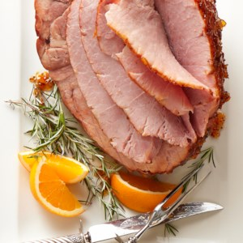
Types of meat I eat:
Chicken
Ham

Slide 10
So, that's all I hope you like my presentation.
Bye! Have a nice day/night! :D
.
.
)

Slide 11
Pages I used:
https://www.google.de/search?q=unicorn&tbm=isch#imgrc=RxedXvO7LoQGdM
https://www.google.de/search?q=dairy&tbm=isch#imgrc=wvSpwGfsPDAx6M
https://www.google.de/search?q=Happy%20Stickman&tbm=isch#imgrc=S8S-qqFGqvH_2M
https://www.google.de/search?q=Fruits&tbm=isch#imgrc=irdmsygEt6tyqM
https://www.google.de/search?q=%C5%82adne+t%C5%82o&tbm=isch&ved=2ahUKEwjQzu3mmMDoAhWOCHcKHSsCAxwQ2-cCegQIABAA&oq=%C5%82adne+t%C5%82o&gs_lcp=CgNpbWcQAzICCAAyBAgAEB4yBAgAEB4yBAgAEB4yBAgAEB4yBAgAEB4yBAgAEB4yBAgAEB4yBAgAEB4yBAgAEB5QwxpYwxpgkh1oAHAAeACAAUyIAUySAQExmAEAoAEBqgELZ3dzLXdpei1pbWc&sclient=img&ei=2diAXpD-GI6R3AOrhIzgAQ&gl=de&hl=de#imgrc=O0rRnQ4HP1jaiM
https://www.google.de/search?q=vegetables&hl=de&gl=de&tbm=isch&source=lnms&sa=X&ved=0ahUKEwjuitTpnMDoAhVmsYsKHXNeDMEQ_AUIxAEoAQ&biw=1366&bih=623#imgrc=64x4kWbGZrGSaM&imgdii=LjdYg0Y4HocvCM
https://www.google.de/search?q=bia%C5%82e+t%C5%82o&hl=de&gl=de&source=lnms&tbm=isch&sa=X&ved=2ahUKEwint761nMDoAhVNy6QKHVbPDTcQ_AUoAXoECAsQAw#imgrc=9H6VWj9CxWmaDM
https://www.google.de/search?q=vegetables+names+in+British&tbm=isch&ved=2ahUKEwjH9vSopcDoAhVNW5oKHYxDDQUQ2-cCegQIABAA&oq=vegetables+names+in+British&gs_lcp=CgNpbWcQAzoECAAQE1D9SVi4YmD5ZWgAcAB4AIABZIgB7QaSAQQxMC4xmAEAoAEBqgELZ3dzLXdpei1pbWc&sclient=img&ei=-eWAXoeWCs226QSMh7Uo

